Slide 1
Mental Health Support Chatbot

Slide 2
Problem Statement
Anxiety and stress among young adults and students are rising
Stigma and limited access delay help-seeking
Students need a private, approachable first step

Slide 3
Target Users
Primary: Young adults & students (16–28)
Contexts: exam pressure, loneliness, transitions, burnout risk
Needs: immediate support, coping skills, gentle guidance to resources

Slide 4
AI Solution (MVP)
Supportive chat: empathetic, non-judgmental conversations
Daily mood tracking (1–5) with notes + 14-day trend chart
Breathing exercise: in-the-moment inhale/hold/exhale timer
Resource panel: localized safety guidance
Safety rails: crisis keyword detection with urgent banner
Optional GPT replies via .env key; offline local fallback

Slide 5
Architecture

Slide 6
High-Level Design
Streamlit UI (Python)
Empathy engine (local) ↔ optional GPT
Safety checker (crisis detection)
SQLite storage: users, chats, mood logs
Breathing module (timed prompts)
Resources: country-aware messages

Slide 7
Data Model
users(user_id, display_name, created_at)
mood_logs(id, user_id, date, mood, note)
chat_logs(id, user_id, ts, role, content)

Slide 8
Safety, Ethics & Privacy

Slide 9
Principles
Not a medical device; no diagnosis or treatment claims
Crisis detection → show safety banner + urge real-world help
Transparent boundaries in UI
Local storage by default; GPT only if key provided
Customizable resources for each country/campus

Slide 10
Product Walkthrough

Slide 11
Key User Flows
Daily check-in: record mood + notes → view recent trend
Supportive chat: short, warm replies + gentle follow-ups
In-the-moment calm: start breathing cycles from sidebar
Crisis safeguard: urgent banner if high-risk phrases detected

Slide 12
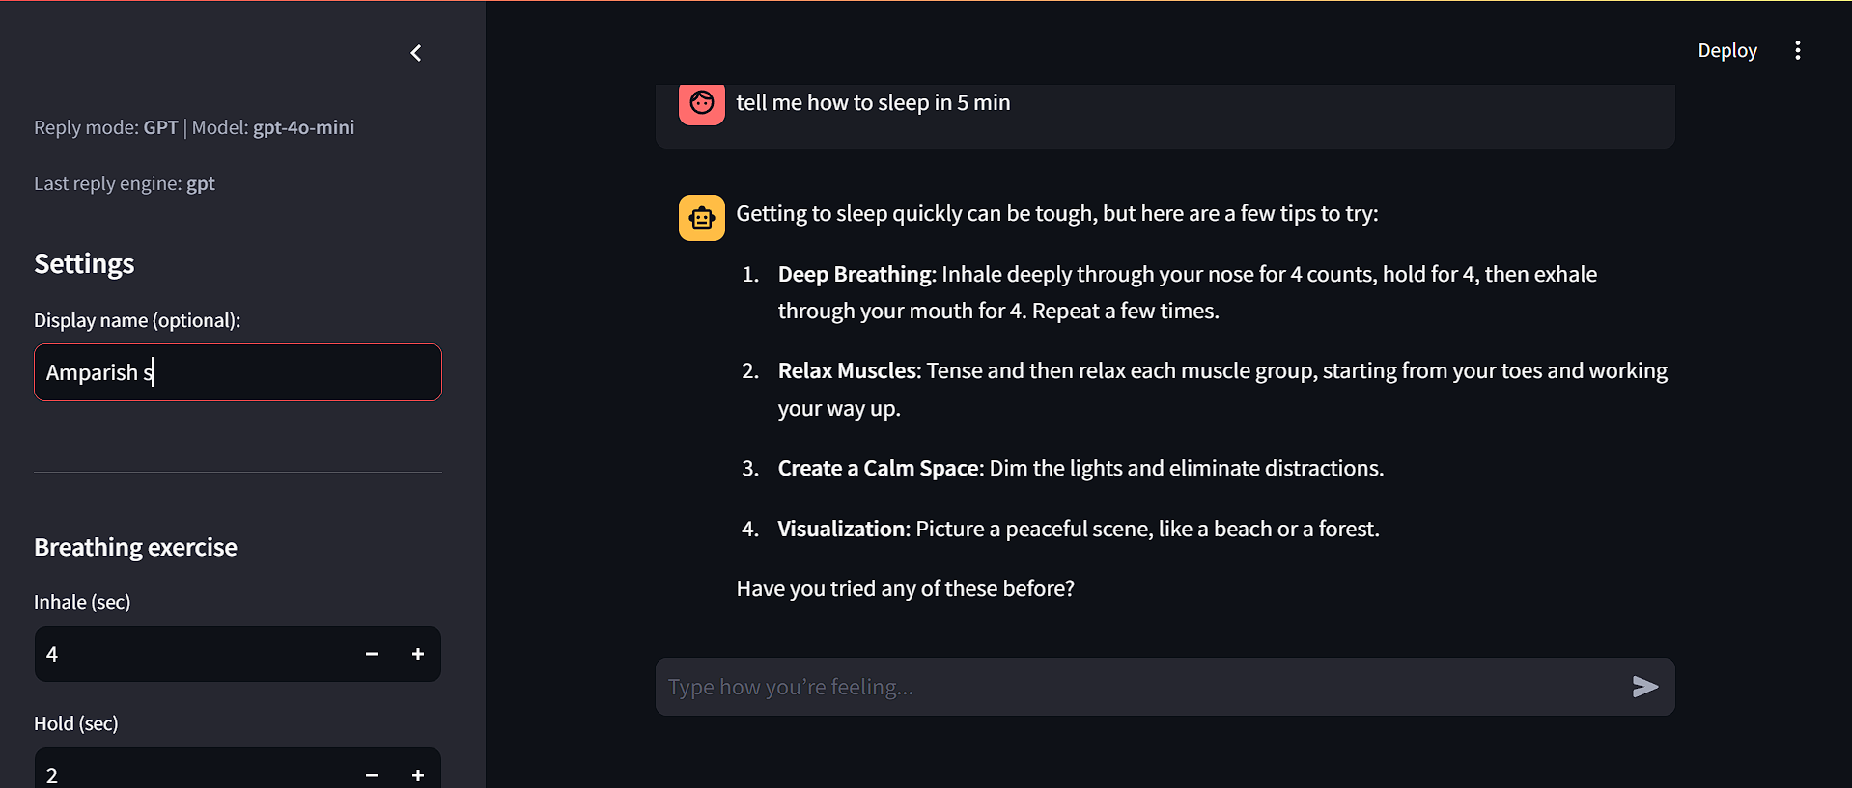
UI Snapshot

Slide 13
Setup & Run

Slide 14
Local Setup
Python 3.10+; create venv
pip install -r requirements.txt
streamlit run app/streamlit_app.py
Optional GPT: create .env
OPENAI_API_KEY=sk-...
OPENAI_MODEL=gpt-4o-mini

Slide 15
Live Demo (5 min)
1) Save a mood & note → show chart update
2) Ask for a grounding exercise
3) Start breathing (2–3 cycles)
4) Trigger safety banner (simulate text, don’t glamorize)
5) Show GPT ↔ Local toggle via .env

Slide 16
Impact & Evaluation

Slide 17
Success Metrics
Weekly active users (WAU) / 7-day retention
Daily check-ins per user
Completion rate of breathing cycles
Time-to-first support after onboarding
Anonymous feedback (helpfulness, safety)

Slide 18
Thank you
PRESENTED BY AMPARISH S,

